Slide 1


Metasearch Engine
Tadhg Foley R00086562

Slide 2
Introduction
Name: Tadhg Foley
Student Number : R00086562
Coarse: I.T Management
Project: Metasearch Engine
Supervisor: Tim Horgan

Slide 3
Work Experience
Work experience :
PFH (I.T Support)
Macom (I.T Support)
Rubicon Centre

Slide 4
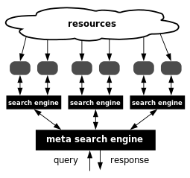
What is Meta Search Engine ?
A metasearch engine is a search tool that uses another search engine's data to produce their own results from the Internet. Metasearch engines take input from a user and simultaneously send out queries to third party search engines for results.

Slide 5
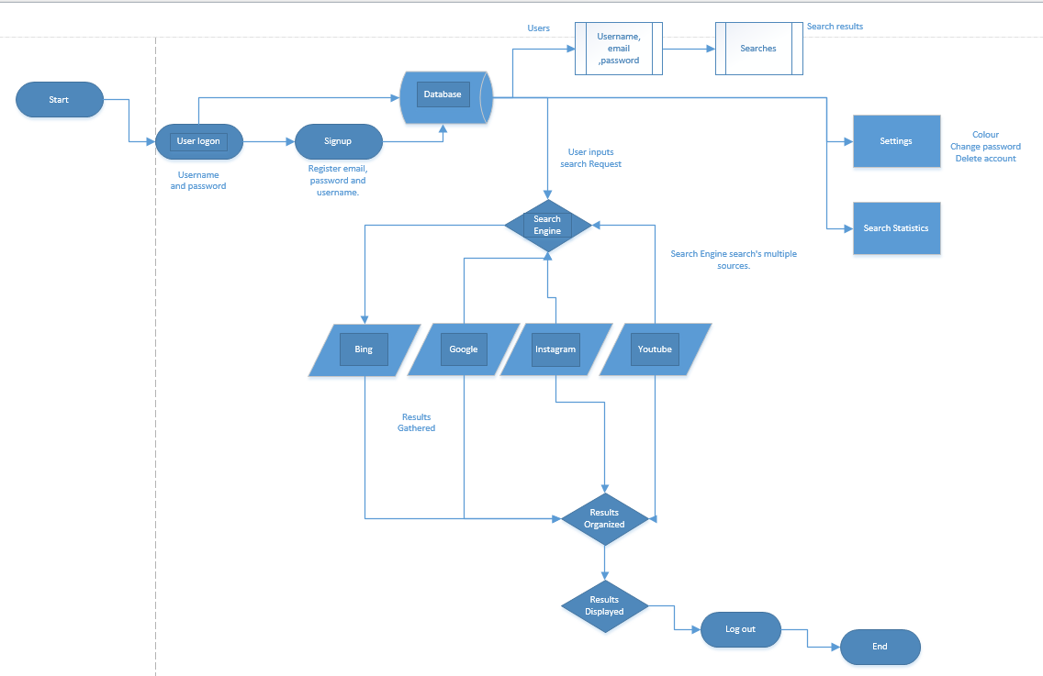
My Plan for a meta search engine

Slide 6
Project Background
Rubicon Centre
Hatchery Scholarship
Change of ideas
Basic Idea Not working
After that
Learning programming
Networking
Work Placement

Slide 7















So using these Tools

Slide 8
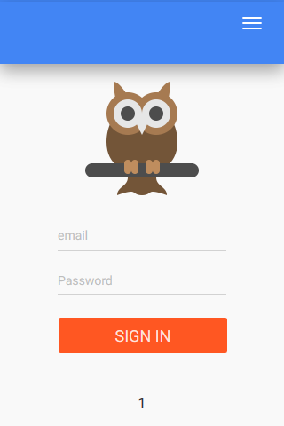
….. I created this, WootBuddy
Woot Buddy is the open source search engine all in one. See what people are searching in real time.
It uses the skills I have learnt form college
It uses
Google
Bing
DuckDuckGo
Instagram
Twitter

Slide 9
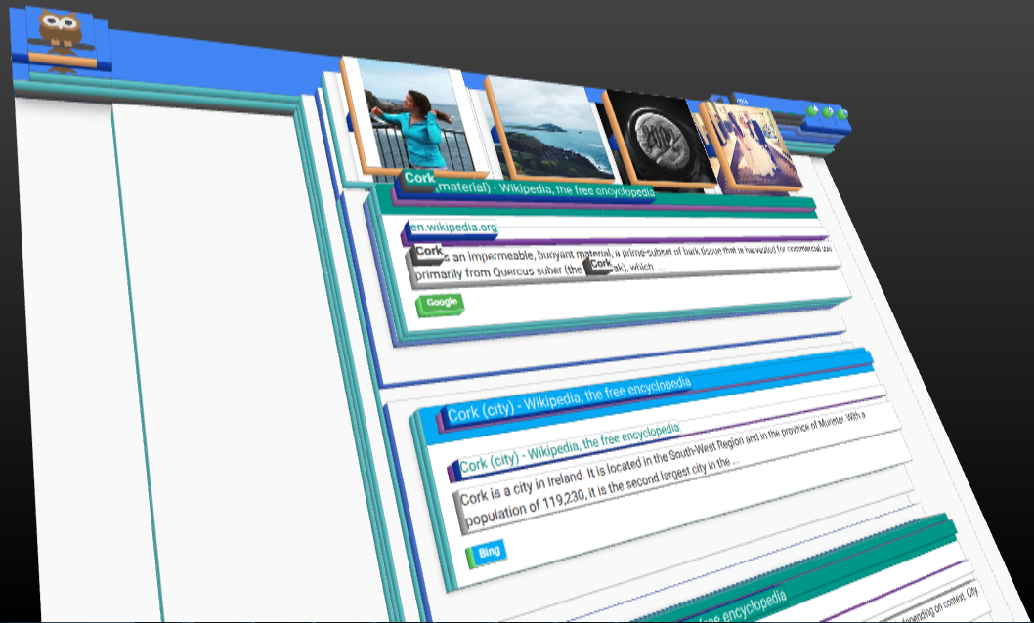

….. I created this

Slide 10
Project Goals
A search engine that searches multiple search engines.
A Social Network of sorts (login, signup, share searches etc)
Gather Statistics on the users and searches.
Using Search Engine APIS.
Create a Mvc Framework in php.
Setting up a developer server.
A level sorting of results
A Great User Interface

Slide 11
Project Requirements & Deliverables
Must Have
Signup.
Login.
Edit profile.
Edit settings.
Search the Google
Search the Bing
Search the DuckDuckGo
Search the Instagram
Post to Twitter
Pick if there results are post to Twitter or not
Log out
Work on all mobile and desktop browsers with html5
Reset Password
Give user feedback
Gather Statistics

Slide 12
Demo

Slide 13
Project implementation plan
Start date: 2nd February
End date: 18th May
See handout

Slide 14
Project Challenges
Research
Learning new code
Mobile design not always working
Working with apis
Error handling.
Writing and understanding MVC (I cried)
Programming with Dyslexia

Slide 15
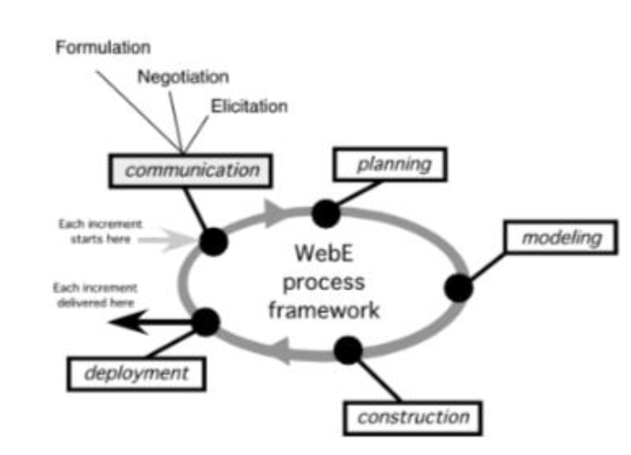
Project Testing
DogFood
Dogfood is an expression that means to use the product or service that you are trying to sell.
Dogfood can be used as a noun, as in the sentence, "A company that eats its own dog food sends the message that it considers its own products to be the best on the market." Or it can be used as a verb, as in the sentence, "We need to dogfood this product before we roll it out to the public."

Slide 16
Future Enhancements
Password encryption
More complicated sorting algorithm
Automated testing
Adding more APIs, etc
Adding more social media outlets
Add social feeds
Open a Woot Buddy Api

Slide 17
Evaluation
Learning other sides of I.T previously not seen.
Learning better time management.
Learning to set realistic goals
Using what i was taught in the college.
Handling project problems are they come along.

Slide 18
Questions & Answers

